Slide 1
NLP Analysis of Federal Reserve Meeting Minutes and Economic Indicators
Killari Limbachiya

Slide 2
Introduction
Background
Natural Language Processing (NLP) plays a crucial role in extracting insights from institutional
communications, particularly in the financial sector. The Federal Reserve's meeting minutes
contain valuable information about monetary policy, economic outlook, and market sentiment.
Financial analysts, economists, policymakers, and investors use NLP to analyze trends in central
bank communications to anticipate policy changes and economic shifts.
Organizations utilize central bank communication analysis for:
Market Predictions – Financial institutions monitor central bank language for signals about
future interest rate changes and economic outlook.
Policy Analysis – Economists track shifts in central bank rhetoric to understand evolving
monetary policy frameworks.
Sentiment Tracking – Tracking the sentiment in monetary policy statements helps gauge the
central bank's confidence in economic conditions.
Risk Assessment – Financial institutions use central bank communication analysis to identify
potential economic risks and policy uncertainties.
Economic Forecasting – Analyzing the relationship between central bank language and
economic indicators helps improve economic forecasts.

Slide 3
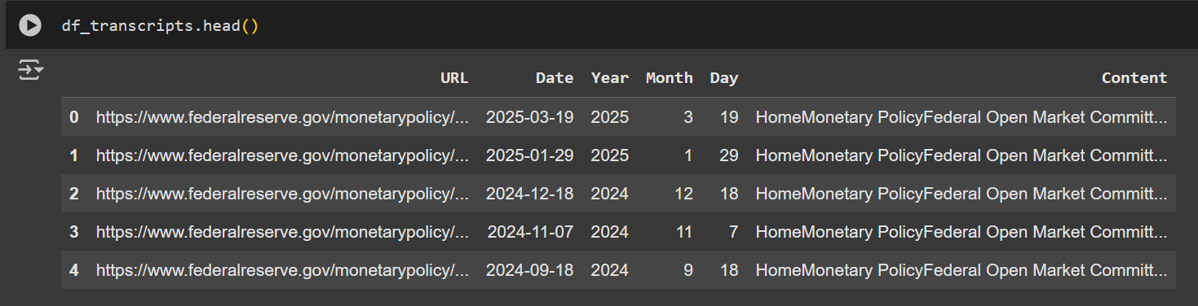
Data Collection
Defined Date Range: Took user input to specify a custom start and end date, filtering out COVID-era years (2020–2021).
Scraped from Federal Reserve Website: Collected FOMC transcript links from both current and historical archive pages.
Parsed Relevant Links: Used regex to extract only those URLs matching meeting minutes formats (e.g., minutesYYYYMMDD.htm).
Extracted Content: For each valid link, scraped the transcript text from the webpage's main div using BeautifulSoup.
Built the DataFrame: Compiled structured data (URL, date, year, month, day, content) into a clean DataFrame df_transcripts for downstream analysis.

Slide 4







End-to-End Flow
Data Collection
Data Preprocessing
Sentiment Analysis (VADER)
Topic Modeling
Scrape FOMC meeting transcripts
Clean and tokenize the text
Classical and modern approaches
LDA – Topic Modeling
Topic Extraction
Extractive Summarization
Transformer based sentiment analysis
FINBERT Topic Extraction
FINBERT Extractive Summarization
Modern NLP Approach – FINBERT Sentiment Analysis

Slide 5
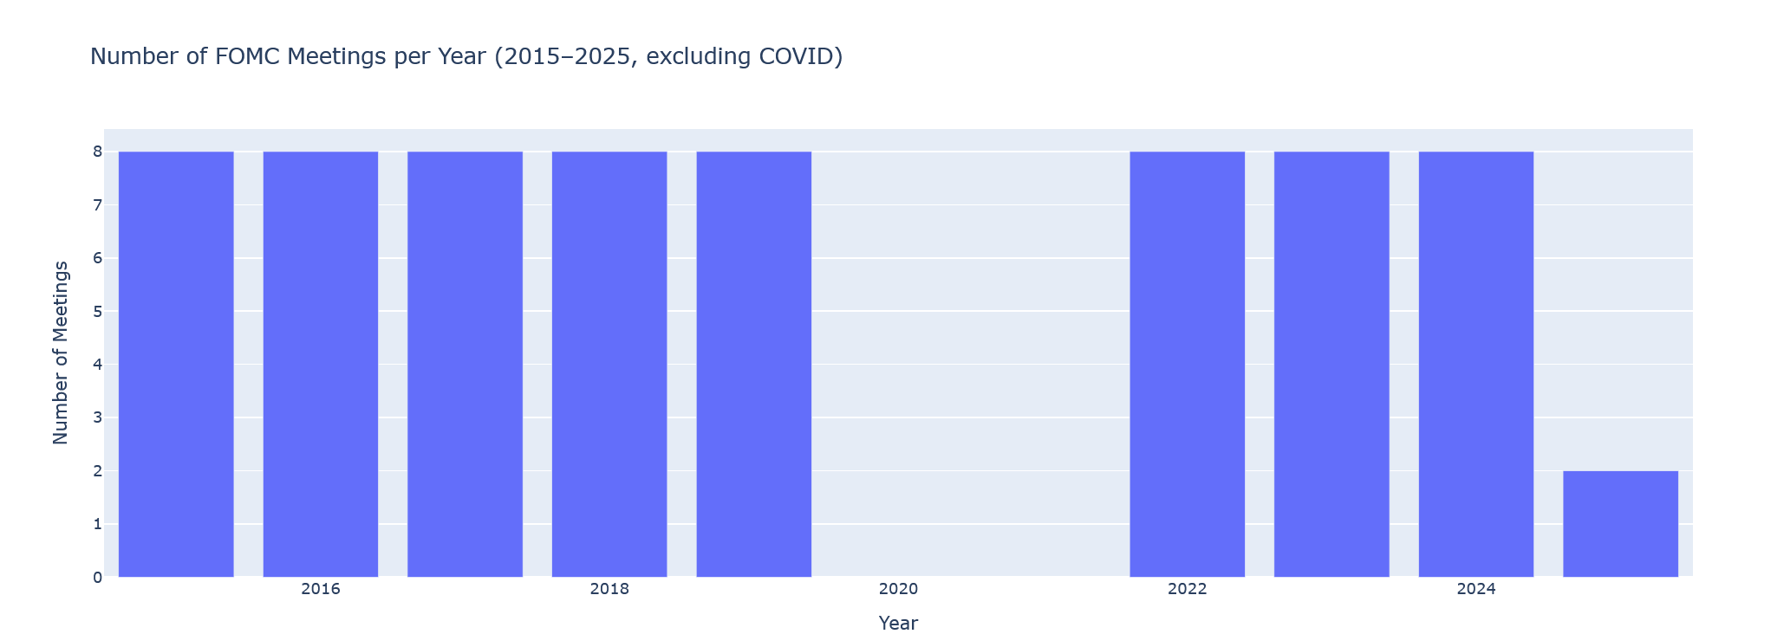
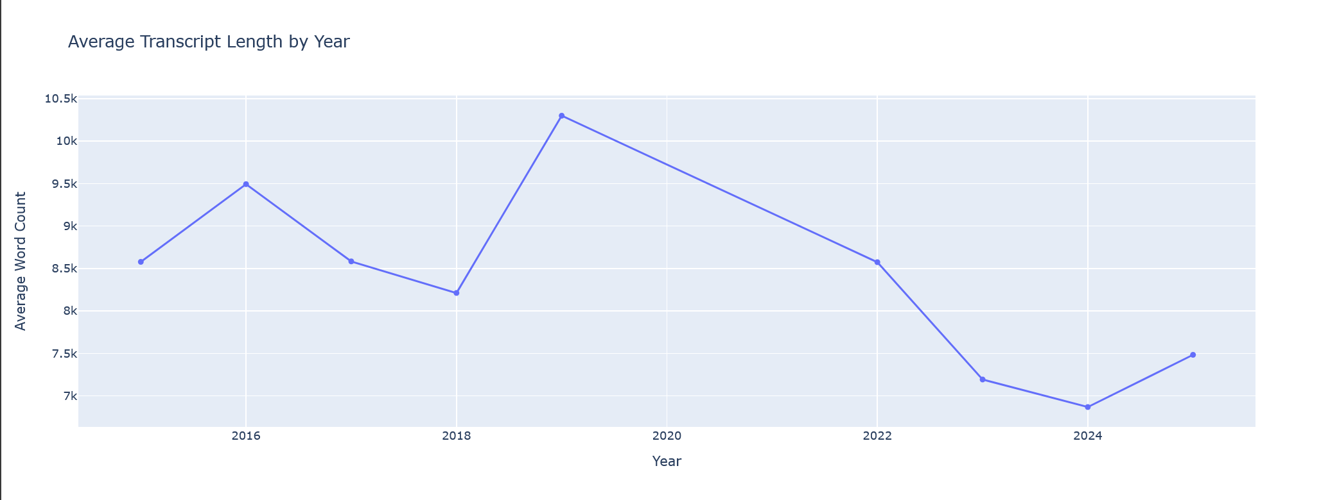
Exploratory Data Analysis
From 2015 to 2023, the Federal Reserve held about 8 meetings every year.
There is no meeting data for 2020 and 2021 because those years were skipped due to COVID.
The number of meetings in 2025 is low, likely because the year is not finished yet.
In 2019, the meeting transcripts were the longest, meaning more was discussed or written.
After 2021, the transcripts got shorter, maybe because the meetings were shorter or more to the point.

Slide 6
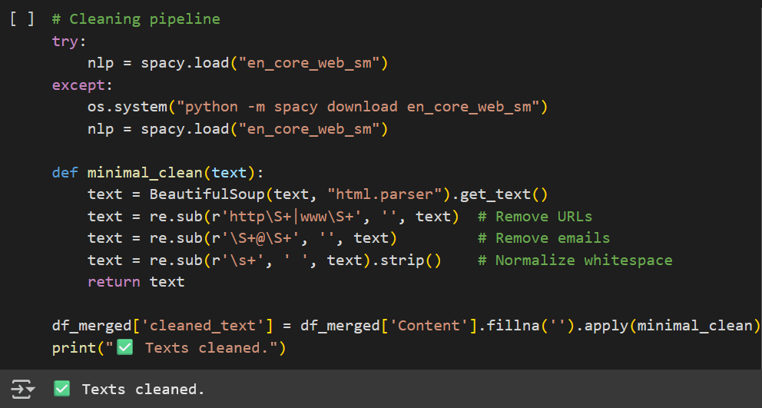
Text Preprocessing
Cleaned text using spaCy.
Custom cleaning function: (minimal_clean) is applied to the content to remove:
URLs (http, www)
Email addresses
Extra spaces
HTML tags are also removed using BeautifulSoup, leaving only the readable text.
The cleaned output is stored in a new column called cleaned_text in the DataFrame df_merged.
A confirmation message "Texts cleaned." is printed after successful cleaning.

Slide 7
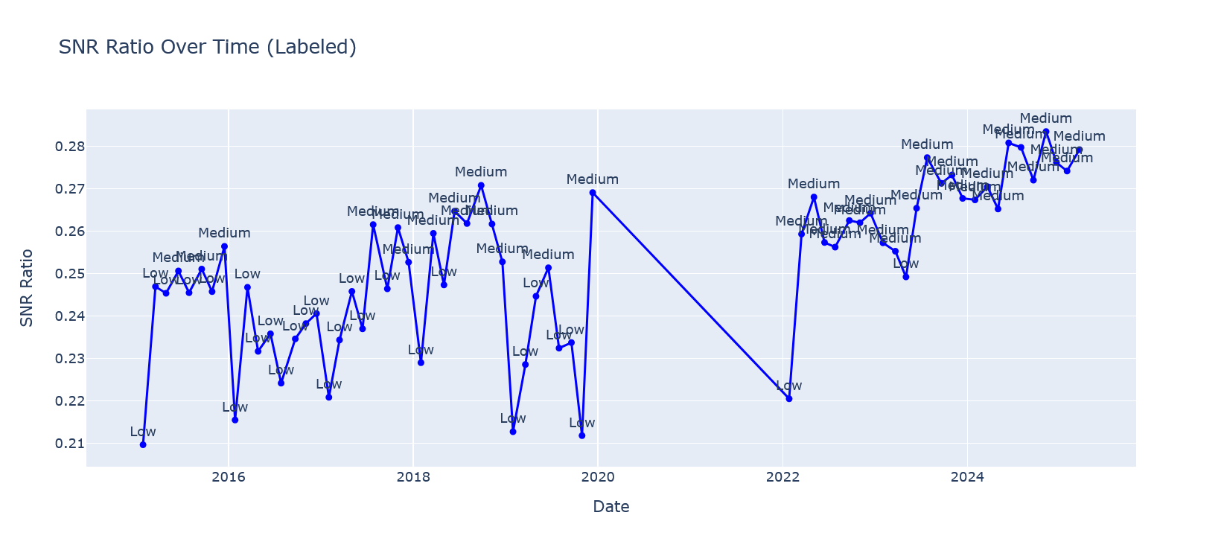
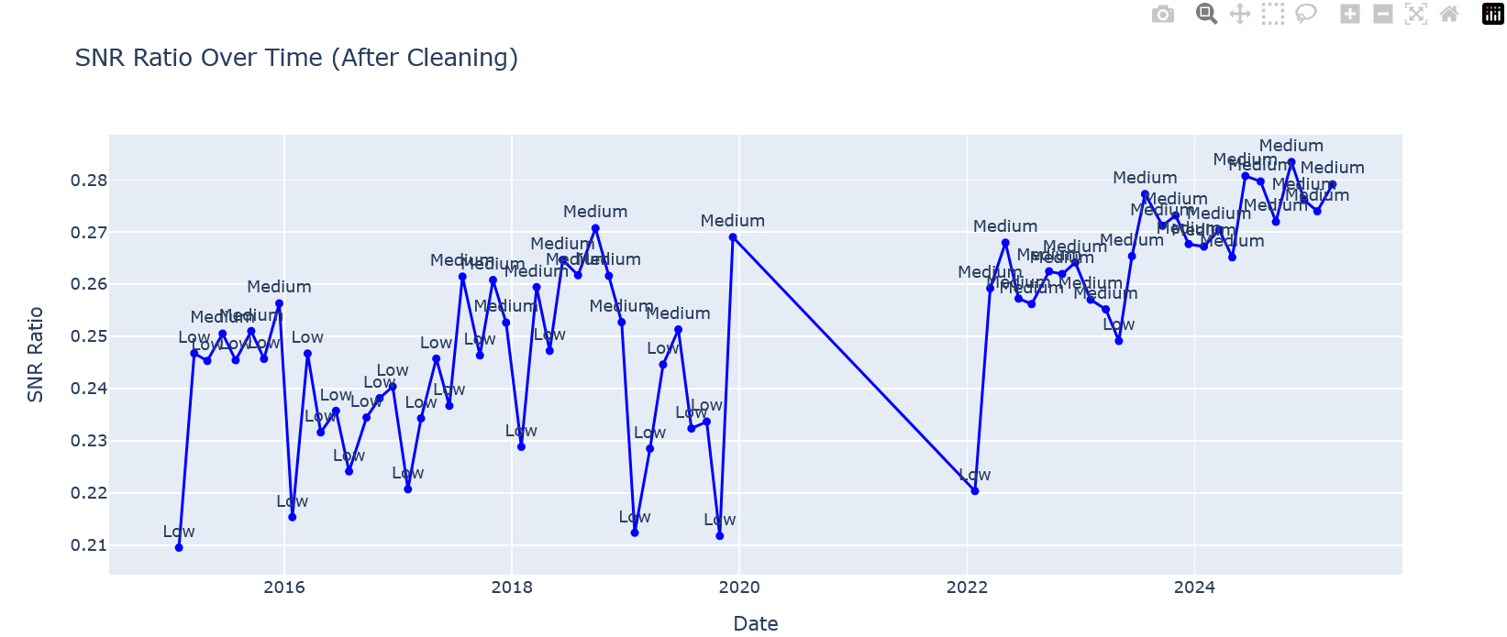
Text Preprocessing – SNR ration before vs after Cleaning
Transcripts are mostly labeled as "Low" or "Medium" clarity over time, with a slight shift toward more "Medium" values in later years.
Before 2020, the SNR ratio was more volatile and often dipped lower, indicating less clarity or noisier communication.
From around 2022 onward, SNR ratios consistently rise and stay in the “Medium” range, showing improved clarity in recent years.
After text cleaning, the overall trend remains the same, but the line is smoother, showing that noise reduction made the data clearer.
No transcript crosses the threshold for a “High” SNR ratio, meaning even the best communications were not extremely clear.

Slide 8
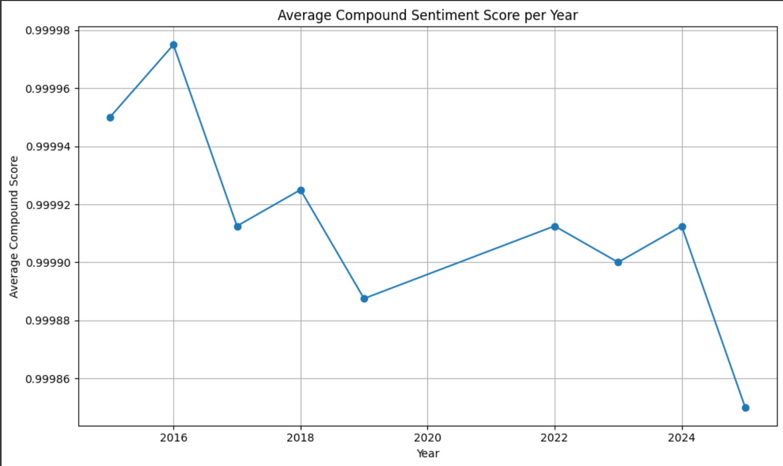
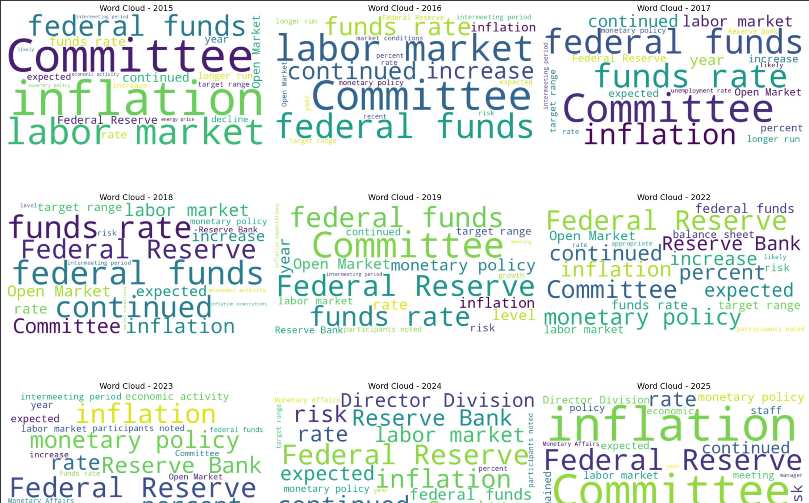
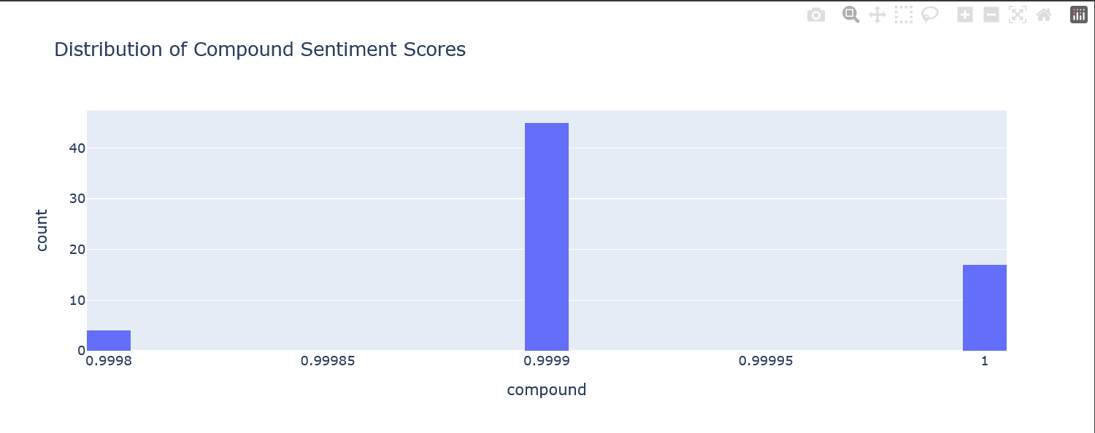
Sentiment Analysis – Classical Approach
The compound sentiment score distribution shows most values are very close to 1, meaning the tone of the transcripts is highly positive overall.
Stable but Slight Decline Over Years: The yearly average sentiment score stays close to 1, but we can see a very slight downward trend from 2016 to 2025, hinting at a slightly less positive tone in recent years.
Word clouds from 2015 to 2025 repeatedly highlight terms like “Federal Reserve,” “Committee,” “Inflation,” “Rate,” and “Labor Market”, showing stable communication focus.
Although the core terms remain, newer years like 2024–2025 introduce more emphasis on words like “Director,” “Division,” and “Staff,” suggesting potential shifts in operational focus or discussion style.
This combination of sentiment trend and word cloud evolution helps track how the Fed’s tone and topics have subtly shifted over time while staying generally optimistic.

Slide 9
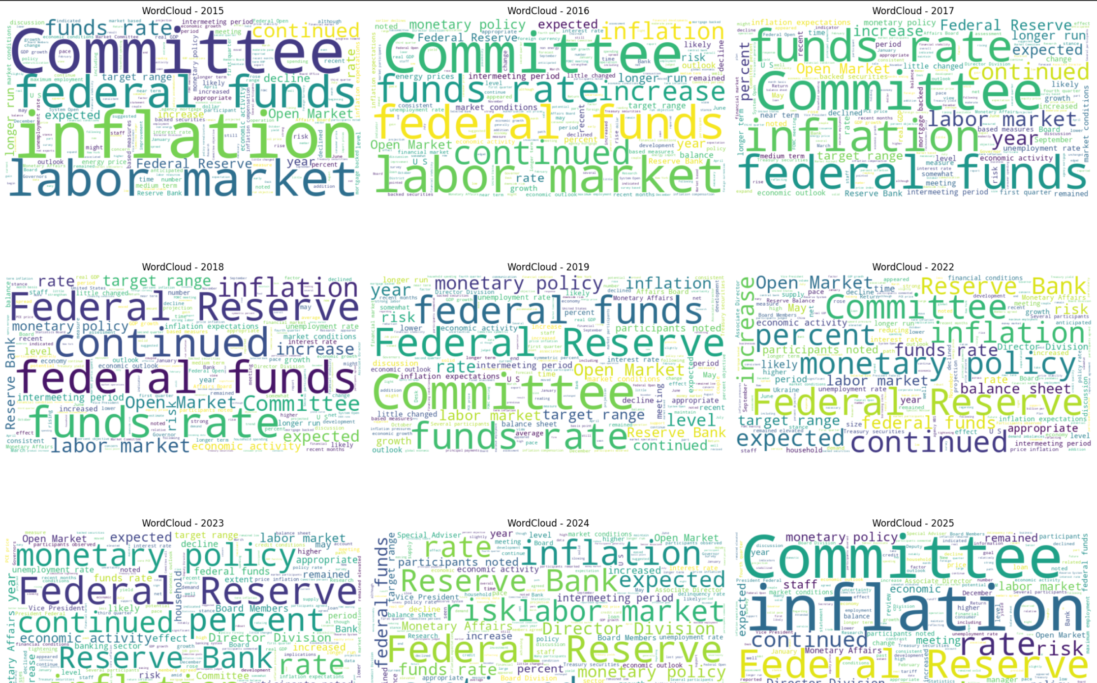
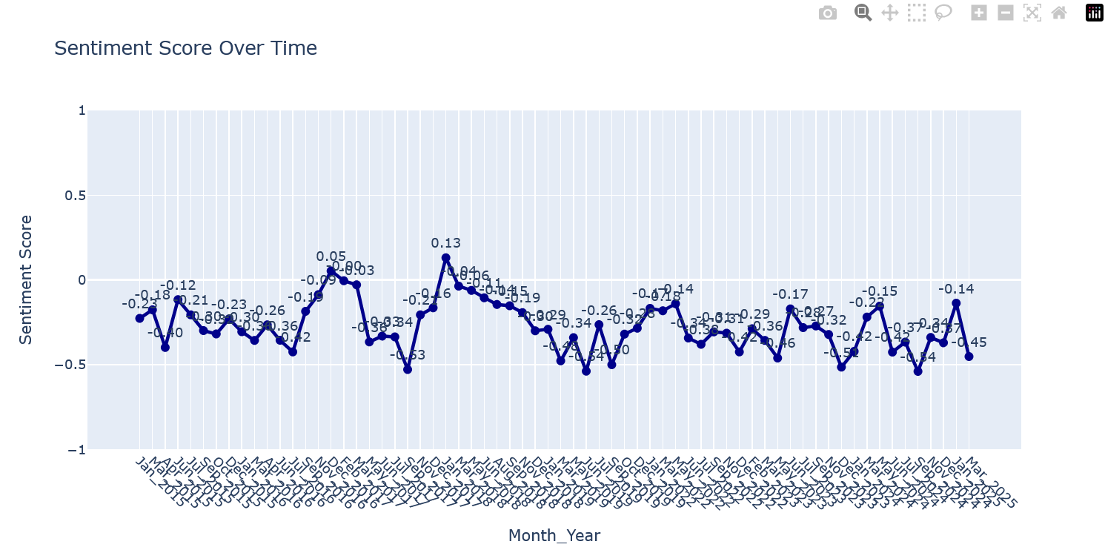
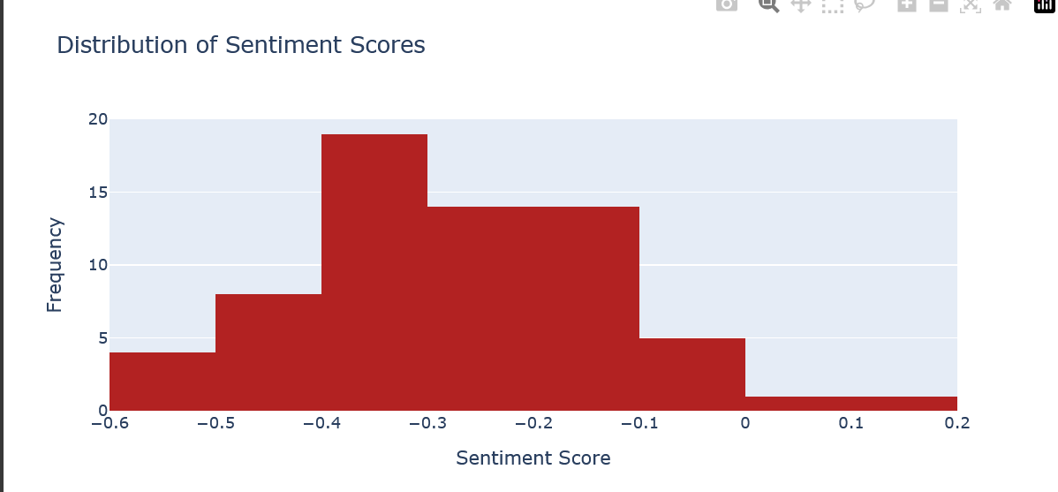
Sentiment Analysis – Modern Approach
The overall sentiment is negative: Most of the scores from FinBERT sentiment analysis are below zero, showing that the tone of Federal Reserve meeting transcripts is generally cautious or slightly pessimistic.
Certain economic terms appear every year: Words like inflation, rate, market, and Federal Reserve show up in every word cloud, proving that these are consistent focus areas for the committee.
Positive mood is rare and short-lived: Occasional small spikes into positive sentiment can be seen in some months, but they don’t last. The general mood always returns to neutral or negative.
Recent years introduce complexity: In more recent years (2023–2025), new words like participants, expected, and risk suggest more complex economic discussions or uncertainty.
Most discussions are moderately negative: The histogram shows that most sentiment scores are in the -0.3 to -0.4 range—not extreme, but definitely more on the negative side.

Slide 10
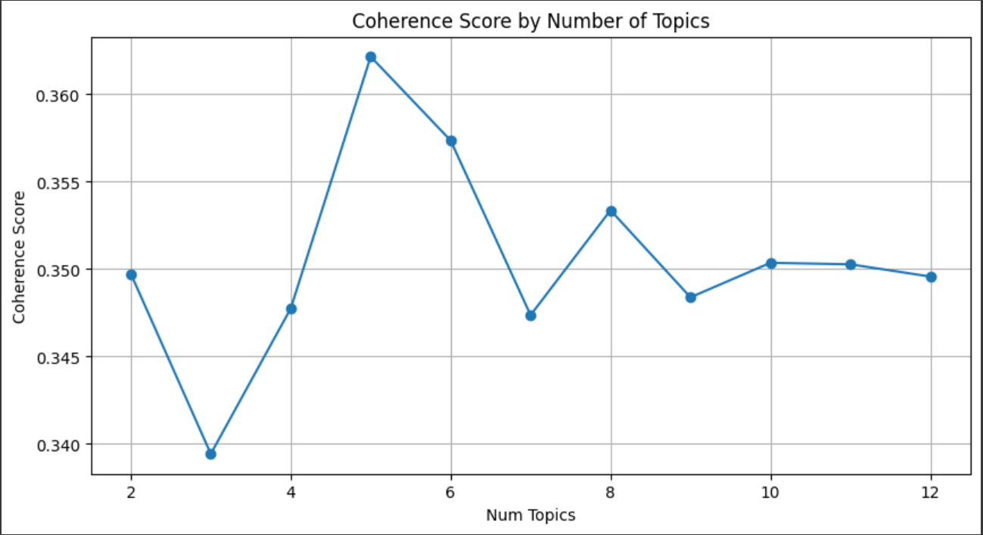
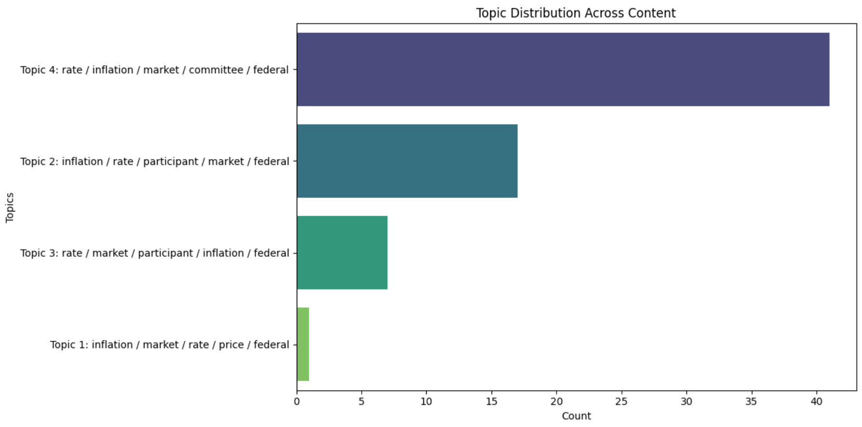
Topic Modeling
Coherence Score by Number of Topics
The coherence score tells how meaningful or interpretable the topics are.
Topic model with 5 topics gave the highest coherence score (~0.362), meaning it's the best balance of clarity and separation.
Adding more than 5 topics didn’t improve the model – scores became flat or slightly worse.
Topic Distribution Across Content
Topic 4 appears most frequently in the documents (over 40 occurrences), showing it's the dominant theme.
The most common words across all topics are rate, inflation, market, committee, and federal — typical financial terms.
Topic 1 is the least common, indicating it's either too narrow or only relevant to a few documents.

Slide 11
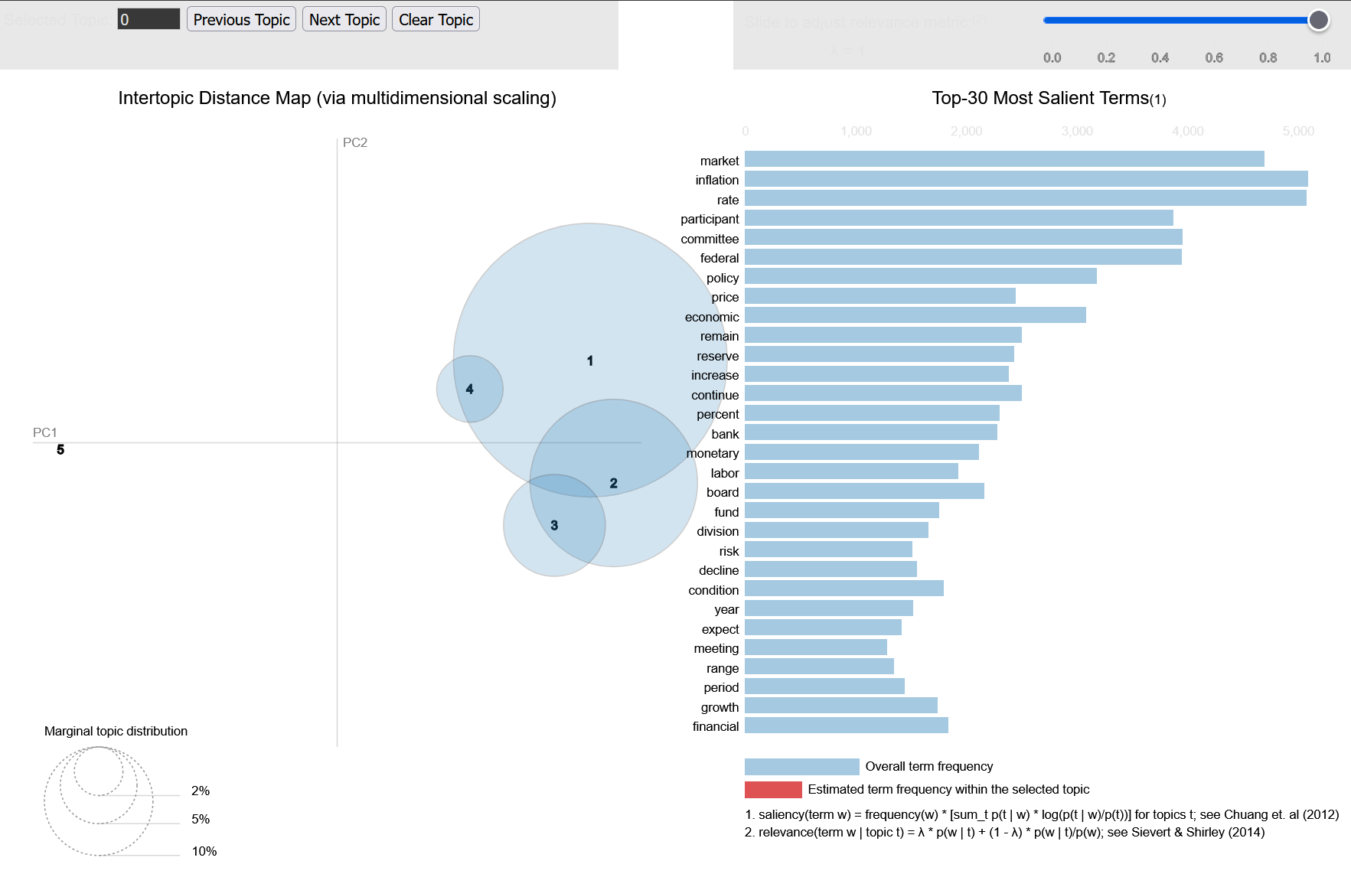
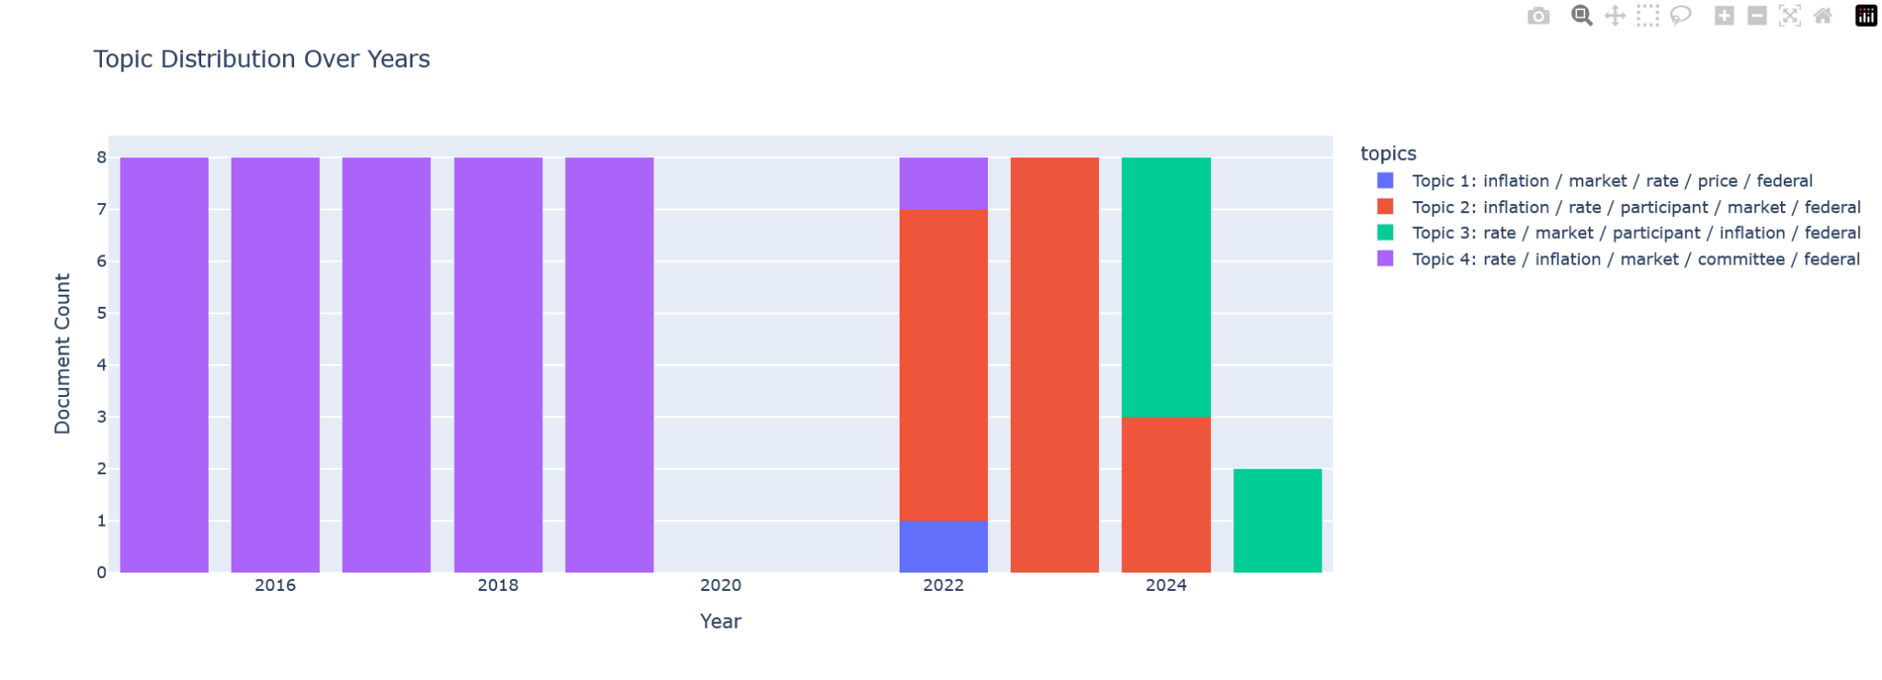
Topic Modeling
Topic Distribution Over Years
From 2015 to 2020, Topic 4 dominated consistently in every year.
Starting 2022, Topic 2 becomes more frequent, reflecting a shift in focus over time.
The introduction of Topic 3 and Topic 1 in later years shows how discussions became more diversified or detailed.
Intertopic Distance Map (LDAvis)
The big, central bubble (Topic 1) covers a large portion of the data, showing it's the main theme.
Topics 2, 3, and 4 are closer to Topic 1, meaning there’s some overlap between their content.
Key recurring terms include market, inflation, rate, federal, and committee — central to Fed communications.

Slide 12
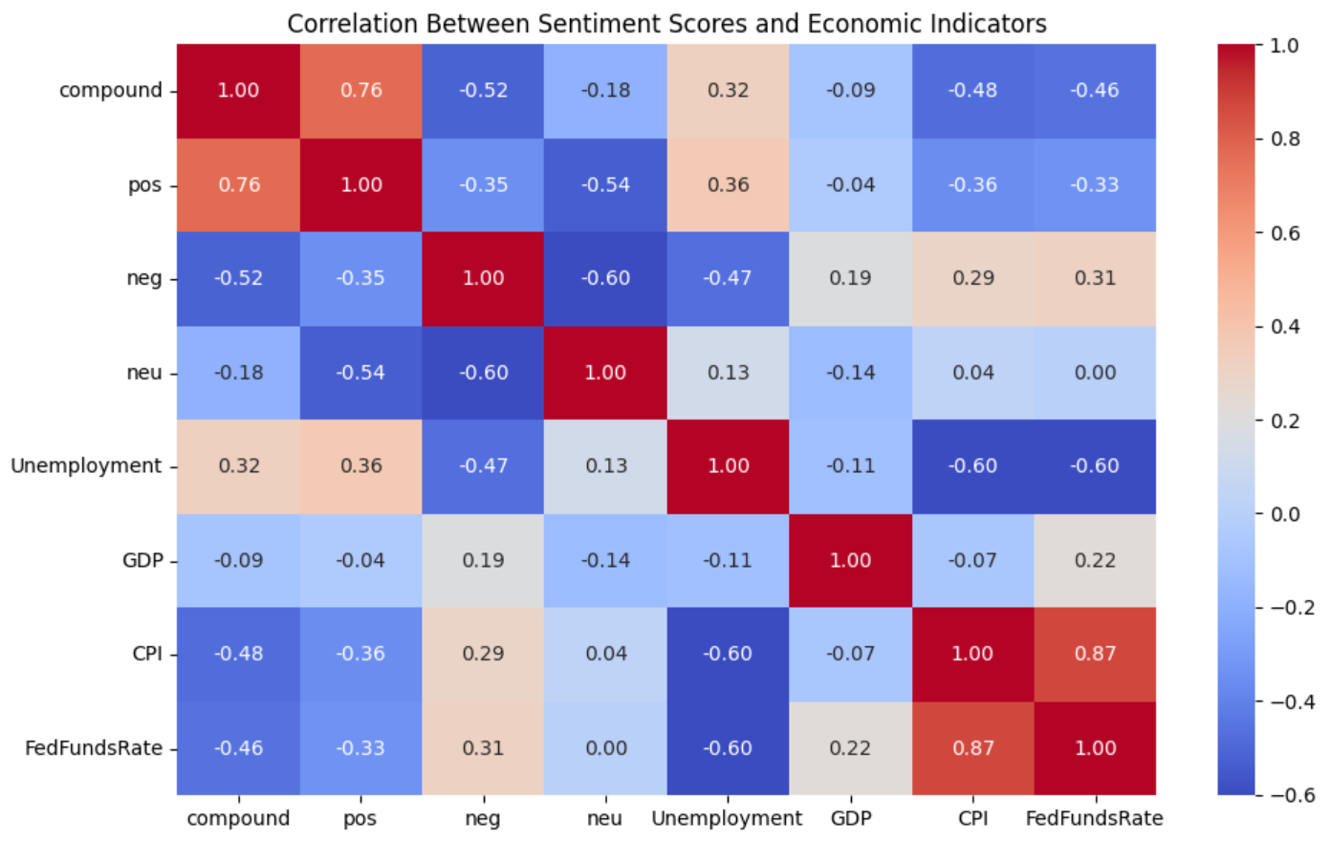
Economic Insights
Positive Sentiment is Strongly Linked to Overall Sentiment:
The compound score (overall sentiment) is highly positively correlated with pos (positive sentiment) at 0.76, which makes sense because more positive words lead to a higher compound score.
neg (negative sentiment) shows a strong negative correlation with both compound (-0.52) and pos (-0.35), meaning when negativity increases, overall and positive sentiment scores drop.
The neu (neutral) sentiment has weak correlations with other sentiment scores and almost zero correlation with most economic indicators — it stays relatively stable.
There’s a positive correlation (0.32) between compound and Unemployment, meaning documents with better sentiment are slightly linked with higher unemployment — this may reflect delayed reporting or context.
CPI (inflation measure) and FedFundsRate are highly correlated (0.87), which aligns with real-world economics — interest rates often follow inflation trends.
neg sentiment is positively correlated with FedFundsRate (0.31), suggesting discussions are more negative when interest rates are high, possibly due to concerns about tighter economic policy.

Slide 13
Conclusion & Future Work
Modern NLP reveals deeper insights vs classical methods.
FOMC language shows predictive power on economic trends.
Next: Fine-tune FinBERT, real-time analysis, dashboard deployment.

